Slide 1
Advanced Database Modelling
Week 3
Dr. Farshid Keivanian

Slide 2
Week 3 overview
Advanced ER Modelling – Introduction
Connectivity & Cardinality
Existence Dependence & Weak Entities
Relationship Strength (Strong vs Weak)
Participation (Optional vs Mandatory)
Special Relationships
Associative Entity
Database Design Considerations
Week 3 Tutorial Activities — Hints for Students
Question 1 — Hot Water (HW) spa company
Let’s do Question 1 together
Question 2 — United Helpers
Common mistakes to avoid
Final Hints for Students
Submission of Tutorials & Assessments
Let’s Answer Your Questions

Slide 3
Advanced ER Modelling – Introduction
Last Week (Quick Recap):
We learned how to draw basic ERDs (Entity–Relationship Diagrams).
Understood Primary Keys (PK) and Foreign Keys (FK).
Saw how entities connect using relationships (1-to-1, 1-to-many, many-to-many).

Slide 4
Advanced ER Modelling – Introduction
This Week:
We’ll level up our ERD skills → moving from simple drawings to real-world database designs.
Explore advanced ER concepts:
Generalization & Specialization (like “family tree” for entities).
Weak Entities (entities that “depend” on others).
Advanced relationships (multi-way, recursive, etc.).

Slide 5
Advanced ER Modelling – Introduction
Analogy: Think of Week 2 as LEGO basics – learning how to connect simple bricks. This week is about building a full LEGO city with roads, buildings, and rules that make it realistic.

Slide 6
Connectivity & Cardinality
Connectivity = type of relationship
1:1 (One-to-One): One passport belongs to one person.
1:M (One-to-Many): One teacher teaches many classes.
M:N (Many-to-Many): Many students join many clubs.

Slide 7
Connectivity & Cardinality
Analogy: Think of it like friendship rules:
One best friend (1:1).
One parent with many children (1:M).
Many friends who belong to many groups (M:N).

Slide 8
Connectivity & Cardinality
Cardinality = min & max number of entities in the relationship
Defines how many instances must/may exist.
Example:
A Netflix account must have at least 1 profile, but can have up to 5.
A Uni subject must have 1+ students enrolled, but there’s a cap (e.g., max 200).

Slide 9
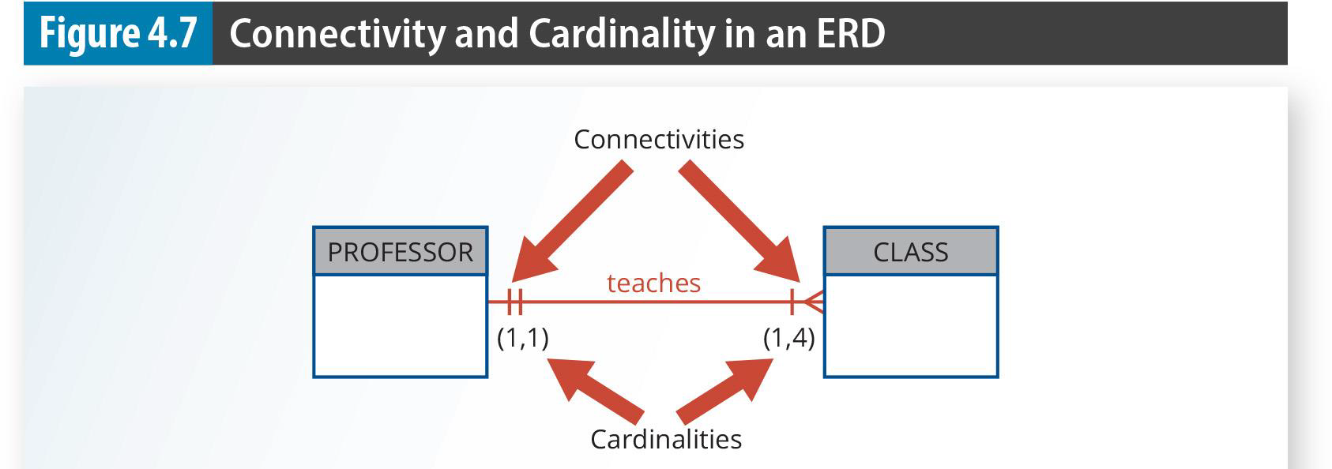
Connectivity & Cardinality
This diagram shows connectivity (type of relationship) and cardinality (how many entities can be linked). Example here: One professor must teach at least 1 class and can teach up to 4 classes (1,4), while each class must be taught by exactly 1 professor (1,1).

Slide 10
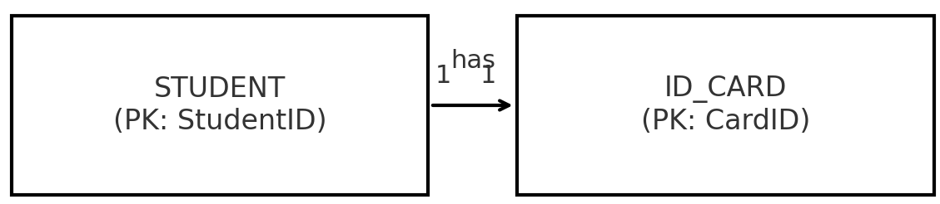
Connectivity & Cardinality
Visual Example (University)
Relationship | Connectivity | Cardinality
Student – ID Card | 1:1 | Each student must have 1 card, only 1 per student
Connectivity = relationship type (1:1, 1:M, M:N).
Cardinality = the min/max numbers (e.g., 0..M, exactly 1).

Slide 11
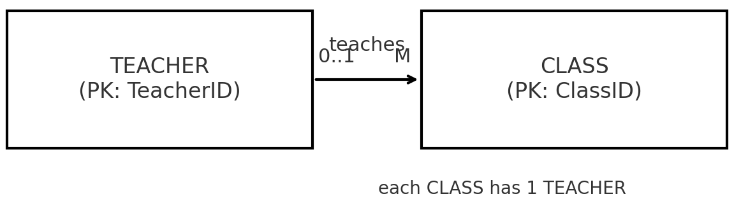
Connectivity & Cardinality
Visual Example (University)
Relationship | Connectivity | Cardinality
Teacher – Class | 1:M | A teacher can teach 0 to many classes; each class has 1 teacher

Slide 12
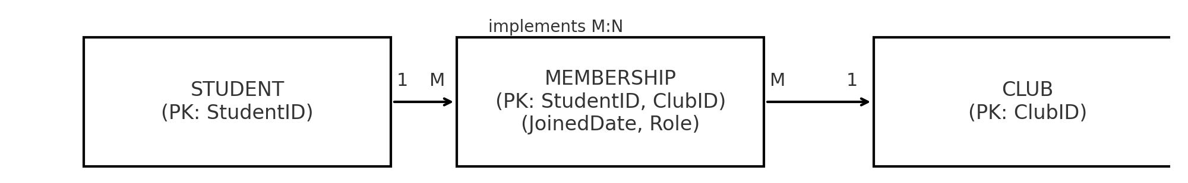
Connectivity & Cardinality
Visual Example (University)
Relationship | Connectivity | Cardinality
Student – Club | M:N | A student can join 0 to many clubs; each club has many students
For M:N, the associative entity (MEMBERSHIP) is used with a composite PK (StudentID, ClubID), so we see how M:N is implemented in a relational model.

Slide 13
Connectivity & Cardinality
Q: Draw the relationship between Driver and Car if:
Each driver may drive many cars.
Each car must have exactly 1 driver.
Answer
Connectivity: 1:M (Driver → Car).
Cardinality: Driver (1..*) ↔ Car (1, 1).
Connectiveness
Driver
Car
drives
(1..*)
(1, 1)
Cardinalities
A driver may drive many cars, but is there a rule saying every driver must drive at least 1 car?
If yes (mandatory) → (1, M).
If no (optional) → (0, M).
may drive many cars (may = optional)

Slide 14
Existence Dependence & Weak Entities
Existence-dependent entity: Cannot exist unless another entity exists. Like a child needs a parent to exist in family records.
Weak entity: Its identity relies on another entity’s Primary Key (PK). It uses part of the parent’s PK + its own attribute.

Slide 15
Existence Dependence & Weak Entities
Analogy (Australia):
A Myki Trip Record cannot exist without a Passenger Card.
Without the passenger, there’s no trip record.

Slide 16
Existence Dependence & Weak Entities
Example Table
Entity | Existence? | Example (Australia)
Passenger Card | Exists independently | Myki Card issued to “Alice Brown”
Myki Trip Record | Needs Passenger Card (existence-dependent) | Trip on 15 Jan 2024, linked to Alice’s card

Slide 17
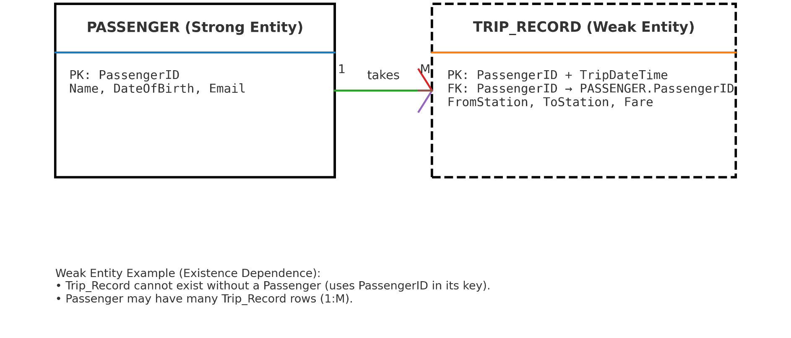
Existence Dependence & Weak Entities
Passenger (Strong Entity) has its own PK
Trip Record (Weak Entity) with a dashed box and composite key → it relies on Passenger’s PK to exist.
The “takes” relationship with 1 → M cardinality
Relationship: “Passenger takes Trip.”

Slide 18
Existence Dependence & Weak Entities
Q: Is an Order Line (line item in an invoice) existence-dependent on an Order? Why?
Yes . An order line cannot exist without an order — it’s a weak entity.

Slide 19
Relationship Strength (Strong vs Weak)
COURSE table
Each course has its own unique course code (CRS_CODE) as the primary key.
CLASS table
Each class has its own independent primary key (CLASS_CODE).

Slide 20
Relationship Strength (Strong vs Weak)
But it also keeps a CRS_CODE as a foreign key to show which course it belongs to.
This means CLASS exists on its own (with its own ID), but still depends on COURSE to know which course it’s teaching.

Slide 21
Relationship Strength (Strong vs Weak)
Real-World Analogy Think of it like:
A Course = “Bachelor of IT.”
A Class = “Monday 9 AM lecture for Bachelor of IT.”
The class has its own identity (time, room, teacher),
But it still points back to the Course it belongs to.

Slide 22
Relationship Strength (Strong vs Weak)
A strong (identifying) relationship happens when the child table uses part of the parent’s primary key as its own.

Slide 23
Relationship Strength (Strong vs Weak)
In this example:
COURSE has CRS_CODE as its PK.
CLASS uses CRS_CODE and CLASS_SECTION together as its PK.
That means a CLASS cannot exist without a COURSE, and the COURSE’s key is literally part of the CLASS’s key.

Slide 24
Relationship Strength (Strong vs Weak)
Real-world analogy: Think of a COURSE as “Accounting I” and CLASS as “Accounting I – Section 1, Monday 8am.” The class ID only makes sense if you know which course it belongs to.

Slide 25
Participation (Optional vs Mandatory)
Optional Participation: An entity can exist without being linked in a relationship.
Example: A student may exist in the database even if they haven’t enrolled in summer class yet.
Mandatory Participation: An entity must be linked in a relationship.
Example: An active student must enroll in at least one subject in a semester.

Slide 26
Participation (Optional vs Mandatory)
Real-World Analogy: Think of joining a gym:
Optional: You can be a member without signing up for any classes.
Mandatory: If you buy a “10-class pass,” you must use it for at least 1 class.

Slide 27
Participation (Optional vs Mandatory)
Example Table
Entity | Relationship | Optional / Mandatory | Example
Student | Summer School Enrollment | Optional | Student may choose not to join summer school.
Student | Semester Enrollment | Mandatory | Every student must take at least one subject per semester.
Course | Class | Mandatory | Each course must generate at least one class.

Slide 28
Participation (Optional vs Mandatory)
Mandatory participation in a relationship:
A course must always generate at least one class (you cannot have a course without a class).
Each class must be linked to a course, and a course must have one or more classes.
The “(1,N)” under Class means a course can generate many classes. (min: 1 and max N)

Slide 29
Participation (Optional vs Mandatory)
In real life: Think of a driving school. Each driving course must have at least one class session and maximum N class session. You cannot advertise a “course” if no classes are scheduled.

Slide 30
Participation (Optional vs Mandatory)
In a hospital database, should every patient have at least one appointment, and should every appointment be linked to a patient? Is this relationship optional or mandatory on each side?
Patient ↔ Appointment
The relationship between Patient and Appointment is optional for the patient but mandatory for the appointment.

Slide 31
Participation (Optional vs Mandatory)
Patient ↔ Appointment
Explanation:
A patient can exist in the system without having any appointments yet, so for the patient it is optional.
But an appointment must belong to a specific patient, so for the appointment it is mandatory.

Slide 32
Participation (Optional vs Mandatory)
Patient ↔ Appointment
In short:
Patient → Appointment: Optional (a patient may have 0 or many appointments)
Appointment → Patient: Mandatory (every appointment must have a patient)

Slide 33
Special Relationships
Unary (recursive): entity relates to itself.
Example: Employee manages another employee.

Slide 34
Associative Entity
Q) A student can enroll in many courses, and each course can have many students. How can we model this in a database?
This is a many-to-many (M:N) relationship, so we use an associative entity (junction table) to break it into two one-to-many (1:M) relationships.
Associative entity: breaks M:N into 2×1:M.

Slide 35
Associative Entity
Relationship:
One Student can have many Enrollment records.
One Course can have many Enrollment records.
Each Enrollment record links one student to one course.
We create a new table called Enrollment.
Tables:
Student
StudentID (Primary Key)
Name
Other details
Course
CourseID (Primary Key)
CourseName
Other details
Enrollment
StudentID (Foreign Key)
CourseID (Foreign Key)
DateEnrolled
So the Enrollment table connects Students and Courses and converts the many-to-many relationship into two one-to-many relationships.

Slide 36
Associative Entity
Question) Why we need to define enrollment between student and course?
Relational databases cannot directly implement a many-to-many (M:N) relationship, so we need a middle table (Enrollment) to store the connections.

Slide 37
Associative Entity
If we connect Student ↔ Course directly, we cannot properly store which student is in which course.
Example:
Students:
S1 Alice
S2 Bob
Courses:
C1 Math
C2 Programming
Now we must record:
Alice → Math
Alice → Programming
Bob → Math
Where do we store these links? This is why we create the Enrollment table.

Slide 38
Associative Entity
With Enrollment table
Enrollment
Each row represents one student taking one course.
StudentID | CourseID | DateEnrolled
S1 | C1 | 01-Mar
S1 | C2 | 02-Mar
S2 | C1 | 03-Mar

Slide 39
Associative Entity
Another important reason
The Enrollment table can store extra information, such as:
DateEnrolled
Grade
Semester
Status (completed / dropped)
If we connected Student and Course directly, we would have nowhere to store this information.

Slide 40
Associative Entity
We add Enrollment because:
Databases cannot directly store many-to-many relationships.
The middle table records which student takes which course.
It allows us to store extra details about the enrollment.

Slide 41
Database Design Considerations
Good PKs: stable, numeric, not “intelligent.”
Example: Use 12345, not “IT2024-MEL.”
Q: Why is “CarPlateNumber” a bad PK? Suggest a better one.
Bad: Car plates can change → not stable.
Better: Auto-generated CarID.

Slide 42
Week 3 Tutorial Activities — Hints for Students
When reading the case study, do these steps:
Step 1: Find the main entities
Look for the main things the business stores data about. These usually become entities/tables.

Slide 43
Week 3 Tutorial Activities — Hints for Students
Step 2: Find the attributes
For each entity, identify its key details such as ID, name, description, price, phone, etc.

Slide 44
Week 3 Tutorial Activities — Hints for Students
Step 3: Find the relationships
Ask:
Does one record relate to one, many, or none?
Is the relationship 1:1, 1:M, or M:N?

Slide 45
Week 3 Tutorial Activities — Hints for Students
Step 4: Check optional or mandatory participation
Ask:
Can this entity exist without the other one?
Must it always be linked?

Slide 46
Week 3 Tutorial Activities — Hints for Students
Step 5: Look for M:N relationships
If you find a many-to-many relationship, you usually need an associative entity in the middle.

Slide 47
Week 3 Tutorial Activities — Hints for Students
Step 6: Add primary keys and foreign keys
Each entity should have a primary key. Relationships often create foreign keys.

Slide 48
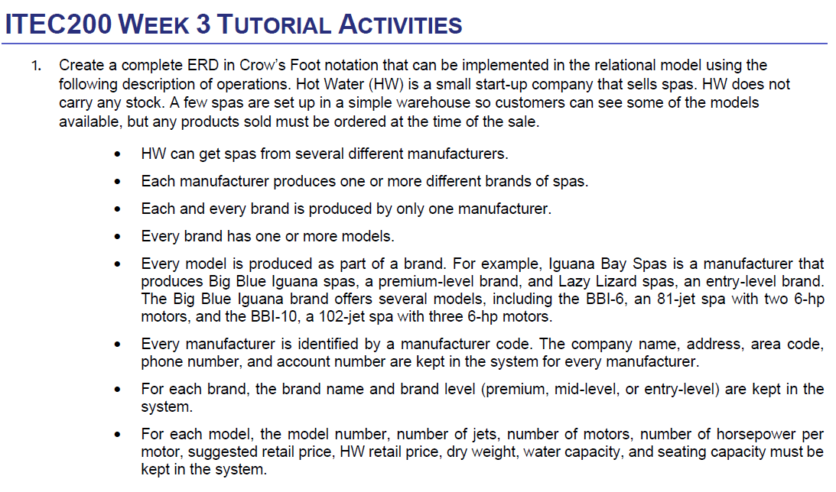
Question 1 — Hot Water (HW) spa company

Slide 49
Question 1 — Hot Water (HW) spa company
Hint 1: Identify the main entities
Look for the main business objects in the description. These usually become entities in the ER diagram.
Ask yourself:
Who supplies the spas?
What product family do they produce?
What specific products are sold?

Slide 50
Question 1 — Hot Water (HW) spa company
You should find three main entities.
Think in this order:
Manufacturer
Brand
Model

Slide 51
Question 1 — Hot Water (HW) spa company
Hint 2: Find the attributes for each entity
The question tells you what information must be stored for each entity.

Slide 52
Question 1 — Hot Water (HW) spa company
Manufacturer attributes
Look for:
ManufacturerCode (Primary Key)
CompanyName
Address
AreaCode
PhoneNumber
AccountNumber

Slide 53
Question 1 — Hot Water (HW) spa company
Brand attributes
Look for:
BrandName
BrandLevel (premium, mid-level, entry-level)

Slide 54
Question 1 — Hot Water (HW) spa company
Model attributes
Look for:
ModelNumber (Primary Key)
NumberOfJets
NumberOfMotors
HorsepowerPerMotor
SuggestedRetailPrice
HWRetailPrice
DryWeight
WaterCapacity
SeatingCapacity

Slide 55
Question 1 — Hot Water (HW) spa company
Hint 3: Work out the relationships carefully
Read the description and convert each sentence into a relationship.

Slide 56
Question 1 — Hot Water (HW) spa company
Examples from the text:
A manufacturer produces several brands
Each brand belongs to only one manufacturer
A brand can offer several models
Each model belongs to one brand

Slide 57
Question 1 — Hot Water (HW) spa company
Ask yourself:
Is it 1:1?
Is it 1:M?
Is it M:N?

Slide 58
Question 1 — Hot Water (HW) spa company
Hint 4: Check minimum and maximum participation
The wording in the question tells you the cardinality and optionality.

Slide 59
Question 1 — Hot Water (HW) spa company
Examples:
“produces one or more brands” → mandatory many
“each and every brand is produced by only one manufacturer” → exactly one
“every brand has one or more models” → mandatory many
“every model is produced as part of a brand” → exactly one

Slide 60
Question 1 — Hot Water (HW) spa company
Watch for key words:
can
may
one or more
only one
every
These help you determine the Crow’s Foot notation.

Slide 61
Question 1 — Hot Water (HW) spa company
Hint 5: Do not invent extra entities
This question only focuses on the product structure.
Do not add extra entities like:
Customer
Order
Sale
unless the question specifically asks for them.

Slide 62
Let’s do Question 1 together
Step 1: Identify the entities
From the description, we find three entities:
Manufacturer
Brand
Model
These represent the hierarchy of spa products.

Slide 63
Let’s do Question 1 together
Step 2: Add the attributes
Manufacturer
Primary Key: ManufacturerCode
Attributes:
ManufacturerCode
CompanyName
Address
AreaCode
PhoneNumber
AccountNumber

Slide 64
Let’s do Question 1 together
Brand
Attributes:
BrandName
BrandLevel
Brand belongs to a manufacturer, so it will also include a foreign key:
ManufacturerCode (FK)

Slide 65
Let’s do Question 1 together
Model
Primary Key: ModelNumber
Attributes:
ModelNumber
NumberOfJets
NumberOfMotors
HorsepowerPerMotor
SuggestedRetailPrice
HWRetailPrice
DryWeight
WaterCapacity
SeatingCapacity
It also belongs to a brand, so it will include:
BrandName (FK)

Slide 66
Let’s do Question 1 together
Step 3: Identify the relationships
Relationship 1
Manufacturer → Brand
From the context:
A manufacturer produces one or more brands
Each brand belongs to one manufacturer

Slide 67
Let’s do Question 1 together
The case says:
“Each manufacturer produces one or more different brands.”
“Each and every brand is produced by only one manufacturer.”
These sentences tell us the minimum and maximum participation.

Slide 68
Let’s do Question 1 together
Manufacturer → Brand
A manufacturer produces one or more brands → Mandatory many
Each brand must belong to exactly one manufacturer → Mandatory one
So this is:
Mandatory one → Mandatory many
NOT optional.

Slide 69
Let’s do Question 1 together
It would be optional if the question said something like:
“A manufacturer may produce brands”
“A manufacturer can have zero or more brands”
But the description clearly says:
“produces one or more brands”
So a manufacturer must produce at least one brand.

Slide 70
Let’s do Question 1 together
One manufacturer produces one or more brands.
Each brand must belong to exactly one manufacturer.

Slide 71
Let’s do Question 1 together
Relationship 2
Brand → Model
From the description:
Every brand has one or more models
Each model belongs to one brand

Slide 72
Let’s do Question 1 together
From the description
“Every brand has one or more models.”
“Every model is produced as part of a brand.”
These words are important:
every brand has one or more models → at least 1 model (not zero)
every model belongs to a brand → exactly 1 brand

Slide 73
Let’s do Question 1 together
One brand must have one or more models.
Each model must belong to exactly one brand.
So both sides are mandatory.
It is mandatory one to mandatory many.

Slide 74
Let’s do Question 1 together
Why it is NOT optional many
It would be optional if the description said:
“A brand may have models”
“A brand can have zero or more models”
But it says:
“Every brand has one or more models.”
So a brand cannot exist without models.

Slide 75
Let’s do Question 1 together
When Designing ERD Structure include PK, FK, and all extra information:
Manufacturer
ManufacturerCode (PK)
CompanyName
Address
AreaCode
PhoneNumber
AccountNumber
Brand
BrandName (PK)
BrandLevel
ManufacturerCode (FK)
Model
ModelNumber (PK)
NumberOfJets
NumberOfMotors
HorsepowerPerMotor
SuggestedRetailPrice
HWRetailPrice
DryWeight
WaterCapacity
SeatingCapacity
BrandName (FK)
produces
offers
One brand has one or more models.
Each model belongs to exactly one brand.

Slide 76
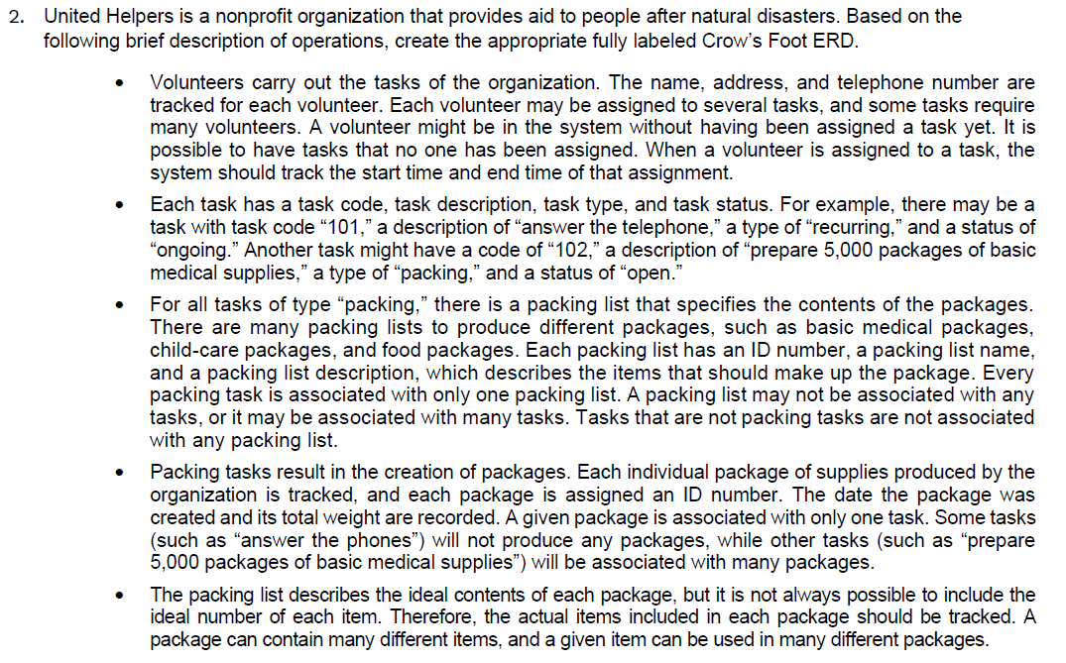
Question 2 — United Helpers
This question is bigger, so solve it piece by piece.

Slide 77
Question 2 — United Helpers
Hint 1: Start by finding the main entities
Read the description and list the main things being tracked.
You should notice entities such as:
Volunteer
Task
Packing List
Package
Item
There may also be associative entities.

Slide 78
Question 2 — United Helpers
Hint 2: Look for M:N relationships
A very important clue is this sentence:
A volunteer may be assigned to several tasks
Some tasks require many volunteers
This is many-to-many.

Slide 79
Question 2 — United Helpers
What should you do?
Create an associative entity between Volunteer and Task.
Also notice:
start time
end time
These belong to the assignment, not just to Volunteer or Task.

Slide 80
Question 2 — United Helpers
So ask yourself:
Which table should store start time and end time?

Slide 81
Question 2 — United Helpers
Hint 3: Packing tasks are a special type of task
Not every task is a packing task.
So think carefully:
All tasks have general task attributes
Only packing tasks use a packing list

Slide 82
Question 2 — United Helpers
Ask:
Does every task need a packing list?
Or only some tasks?
This helps you decide whether the relationship is optional for Task.

Slide 83
Question 2 — United Helpers
Hint 4: Relationship between Task and Packing List
Read this line carefully:
Every packing task is associated with only one packing list
A packing list may be associated with no tasks or many tasks

Slide 84
Question 2 — United Helpers
This tells you:
one packing list can relate to many tasks
a task may or may not have a packing list, depending on task type
So the relationship is not mandatory for all tasks.

Slide 85
Question 2 — United Helpers
Hint 5: Relationship between Task and Package
Read carefully:
Each package is associated with only one task
Some tasks produce no packages
Other tasks produce many packages

Slide 86
Question 2 — United Helpers
This means:
one task to many packages
each package must belong to one task
task side is optional, because some tasks do not produce packages

Slide 87
Question 2 — United Helpers
Hint 6: Relationship between Package and Item
This part is another many-to-many relationship.
Why?
A package can contain many items
An item can appear in many packages

Slide 88
Question 2 — United Helpers
So you need another associative entity between Package and Item.
Also, the question says the system must track:
the quantity of each item placed in each package
That quantity belongs in the associative entity, not in Package or Item alone.

Slide 89
Question 2 — United Helpers
Hint 7: Minimum participation matters
The description says:
It is possible to have items not included in any package yet
Every package will contain at least one item

Slide 90
Question 2 — United Helpers
So think:
Item side can be optional
Package side is mandatory
This is important in your Crow’s Foot notation.

Slide 91
Question 2 — United Helpers
Hint 8: Keep “ideal contents” and “actual contents” separate
Be careful not to confuse:
Packing List = ideal contents of a package type
Package = actual package created
Package–Item relationship = actual items and quantities inside that package
The case mostly asks you to track the actual items in each package.

Slide 92
Question 2 — United Helpers
Hint 9: Solve Question 2 in sections
A good approach is:
Part A
Draw:
Volunteer
Task
Assignment

Slide 93
Question 2 — United Helpers
Part B
Add:
Packing List
relationship with Task
Part C
Add:
Package
relationship with Task

Slide 94
Question 2 — United Helpers
Part D
Add:
Item
Package-Item associative entity
This makes the diagram easier to build and check.

Slide 95
Common mistakes to avoid
Do not put M:N directly in the final relational design
If two entities relate many-to-many, add an associative entity.
Do not place relationship attributes in the wrong entity
Example:
StartTime and EndTime belong to Volunteer-Task Assignment
Quantity belongs to Package-Item

Slide 96
Common mistakes to avoid
Do not ignore optionality
Words like may, can, and might usually mean optional. Words like each, every, and must usually mean mandatory.

Slide 97
Common mistakes to avoid
Do not forget labels
Your ERD should clearly show:
entity names
primary keys
relationship names if needed
cardinality/optionality

Slide 98
Final Hints for Students
Before finishing, check each relationship by asking:
Can one of these have many of the other?
Must one exist before the other can exist?
Is this really M:N?
Do I need a middle table/entity?
Where should this attribute really go?

Slide 99
Submission of Tutorials & Assessments
These guidelines are designed to support your learning and help you apply necessary techniques effectively. Please do the remaining parts/questions and follow the instructions based on Canvas. If you have any questions, feel free to ask—I’m happy to help!

Slide 100

Attendance

Slide 101

Let’s Answer Your Questions
Live during class – Ask directly during sessions.
Canvas Inbox – For structured academic queries.
Email – For formal communications or attachments.
Canvas Discussion Forum – Everyone can see and learn from your question.

Slide 102

Thank You
Happy Learning and Bright Futures Ahead!
Stay Connected: linkedin.com/in/farshid-keivanian github.com/FarshidKeivanian
Education is the most powerful weapon you can use to change the world. — Nelson Mandela

